Slide 1


Slide 2
Math => Quantum Computing => Code => Project

Slide 3
Basic quantum computing
Dr. Nguyen Van Duy, Phenikka Univ
Dr. Vu Tuan Hai, UIT-VNUHCM
Outline:
Overview
Quantum gate: single & multi-qubit
Quantum circuit: single & multi-qubit
Measurement
Encoding/Embedding

Slide 4
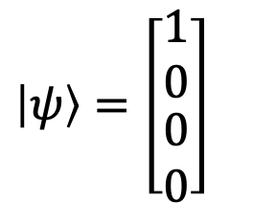
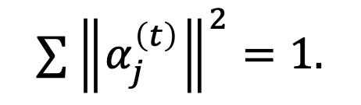
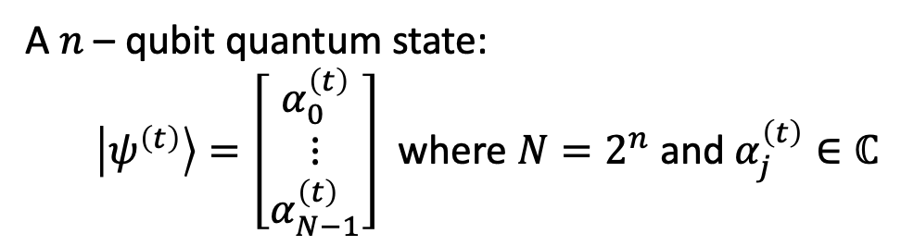
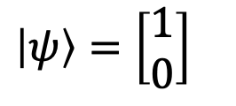




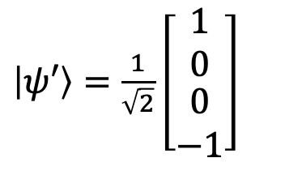
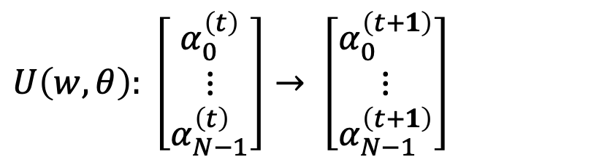
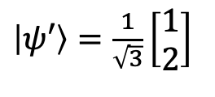
Overview
A $n$ – qubit quantum state:
  $\left|ψ^{\left(t\right)}\right\rangle =\left[\begin{matrix}α_{0}^{\left(t\right)} \\ ⋮ \\ α_{N−1}^{\left(t\right)}\end{matrix}\right]$ where $N=2^{n}$ and $α_{j}^{\left(t\right)}∈ℂ$
1-qubit
2-qubit
$\left|ψ\right\rangle =\left[\begin{matrix}\begin{matrix}1 \\ 0\end{matrix} \\ \begin{matrix}0 \\ 0\end{matrix}\end{matrix}\right]$
$\left|ψ\right\rangle =\left[\begin{matrix}1 \\ 0\end{matrix}\right]$
$$∑{\left\|α_{j}^{\left(t\right)}\right\|}^{2}=1.$$
A quantum gate update amplitudes:
$$U\left(w,θ\right): \left[\begin{matrix}α_{0}^{\left(t\right)} \\ ⋮ \\ α_{N−1}^{\left(t\right)}\end{matrix}\right]→ \left[\begin{matrix}α_{0}^{\left(t+1\right)} \\ ⋮ \\ α_{N−1}^{\left(t+1\right)}\end{matrix}\right]$$
$$U$$
$$U$$
where $w$ and $θ$ are wires and parameter (if applicable). Our target is:
$\left|ψ′\right\rangle =\frac{1}{\sqrt{2}}\left[\begin{matrix}\begin{matrix}1 \\ 0\end{matrix} \\ \begin{matrix}0 \\ −1\end{matrix}\end{matrix}\right]$
$\left|ψ′\right\rangle =\frac{1}{\sqrt{3}}\left[\begin{matrix}1 \\ 2\end{matrix}\right]$
$$\left|ψ^{\left(m\right)}\right\rangle =U|ψ^{(0)}⟩$$
Notes:
The state, gate and operator presented in the last slide can be viewed as vector and matrix in the state-vector approach.
A state is simply a normalized vector which has dimensional two exponential of n where n is the number of qubits.
Because the length of state is only 1, so each element on state always has the norm less or equal 1.
The gate and operator is actually the matrix which has the element is the complex number.
A operator can be reconstructed by tensor multiplication between gates.
And when a operator acts on a state as Eq 1.2, it is equivalent to a matrix-vector multiplication.
But note that the dimensional of both state and operator increase exponentially based on the number of qubits.
Computing this term is a hard problem.

Slide 5














Notation
$$n$$
$$q$$
$$U$$
$$c$$
$$q$$
$$U$$
A quantum gate act on a wire
$$n$$
$$q$$
$$U$$
A $n$-qubit quantum gate act on $n$ wires
$$q$$
Measure qubit $q$
then write down the results to
$$c$$
classical channel $c$

Slide 6
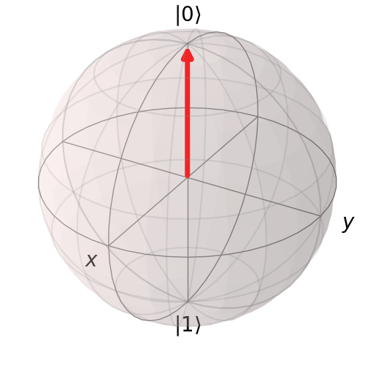

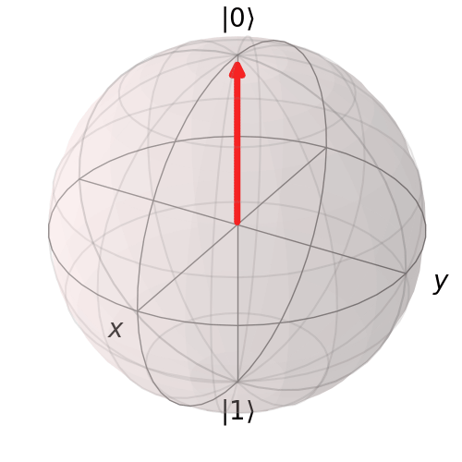
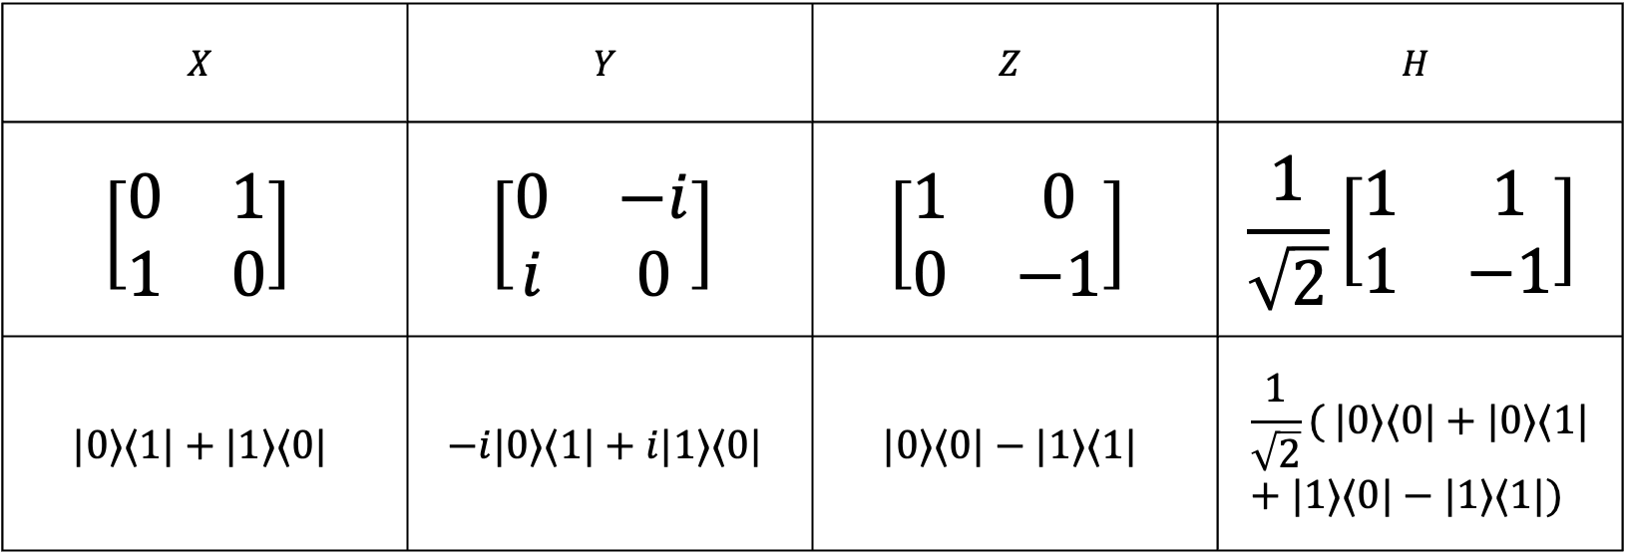
Single qubit gate
Gate
$$X$$ | $$Y$$ | $$Z$$ | $$H$$
$$\left[\begin{matrix}0 & 1 \\ 1 & 0\end{matrix}\right]$$ | $$\left[\begin{matrix}0 & −i \\ i & 0\end{matrix}\right]$$ | $$\left[\begin{matrix}1 & 0 \\ 0 & −1\end{matrix}\right]$$ | $$\frac{1}{\sqrt{2}}\left[\begin{matrix}1 & 1 \\ 1 & −1\end{matrix}\right]$$
$$|0⟩⟨1|+|1⟩⟨0|$$ | $$−i|0⟩⟨1|+i|1⟩⟨0|$$ | $$|0⟩⟨0|−|1⟩⟨1|$$ | $$\frac{1}{\sqrt{2}}( |0⟩⟨0|+|0⟩⟨1|+|1⟩⟨0|−|1⟩⟨1|)$$
Matrix form
Projector form

Slide 7
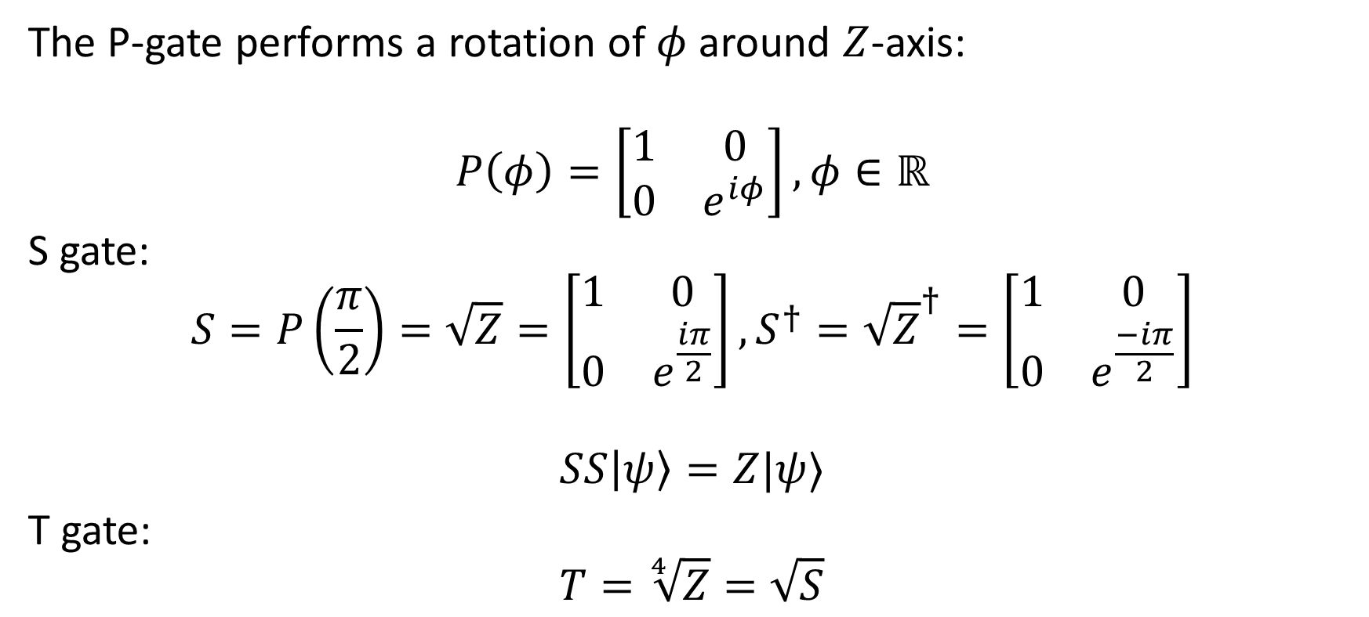
Single qubit gate: phase gate
The P-gate performs a rotation of $φ$ around $Z$-axis:
$$P\left(φ\right)=\left[\begin{matrix}1 & 0 \\ 0 & e^{iφ}\end{matrix}\right],φ∈ℝ$$
S gate:
$$S=P\left(\frac{π}{2}\right)=\sqrt{Z}=\left[\begin{matrix}1 & 0 \\ 0 & e^{\frac{iπ}{2}}\end{matrix}\right], S^{†}={\sqrt{Z}}^{†}=\left[\begin{matrix}1 & 0 \\ 0 & e^{\frac{−iπ}{2}}\end{matrix}\right]$$
$$SS\left|ψ\right\rangle =Z|ψ⟩$$
T gate:
$$T=\sqrt[4]{Z}=\sqrt{S}$$
Parameter

Slide 8
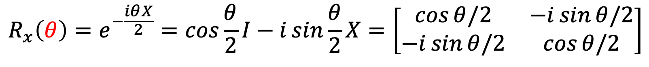


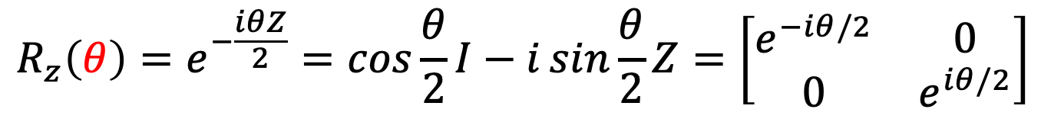
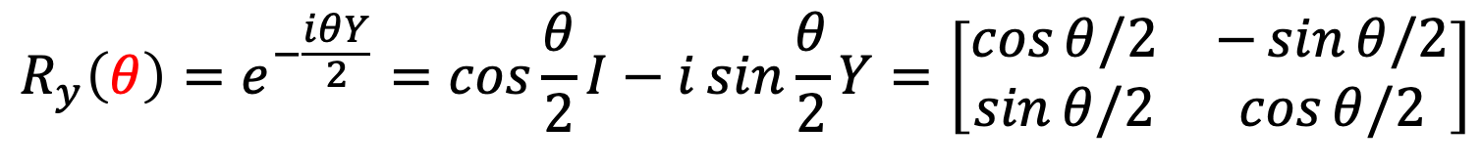
Single qubit gate: parameterized gate
$$R_{x}\left(θ\right)=e^{−\frac{iθX}{2}}=\cos{\frac{θ}{2}I−i\sin{\frac{θ}{2}}X=\left[\begin{matrix}\cos{θ/2} & −i\sin{θ/2} \\ −i\sin{θ/2} & \cos{θ/2}\end{matrix}\right]}$$
$$R_{y}\left(θ\right)=e^{−\frac{iθY}{2}}=\cos{\frac{θ}{2}I−i\sin{\frac{θ}{2}}Y=\left[\begin{matrix}\cos{θ/2} & −\sin{θ/2} \\ \sin{θ/2} & \cos{θ/2}\end{matrix}\right]}$$
$$R_{z}\left(θ\right)=e^{−\frac{iθZ}{2}}=\cos{\frac{θ}{2}I−i\sin{\frac{θ}{2}}Z=\left[\begin{matrix}e^{−iθ/2} & 0 \\ 0 & e^{iθ/2}\end{matrix}\right]}$$
Parameter $θ∈\left[0,2π\right]$
Excercise: Let $x∈ℝ,$ and matrix $A$ such that $A^{2}=I$. Prove:
$$e^{ixA}=\cos{x}I+i\sin{x}A$$

Slide 9

Single qubit gate: universal (U) gate
$U(θ,φ,λ)=\left[\begin{matrix}cos⁡\frac{θ}{2} & {−e}^{iλ}\sin{\frac{θ}{2}} \\ e^{iφ}\sin{\frac{θ}{2}} & e^{i(λ+φ)}\cos{\frac{θ}{2}}\end{matrix}\right]$
$H=U\left(\frac{π}{2},0,π\right),P=U\left(0,0,π\right),…$
Exercise: Representing $U\left(θ,φ,λ\right)$ as combination of $R_{x},R_{y}$ and $R_{z}$

Slide 10
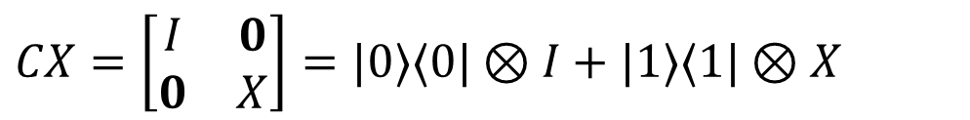



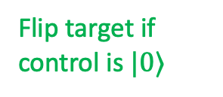
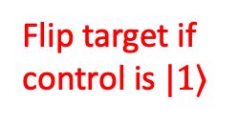

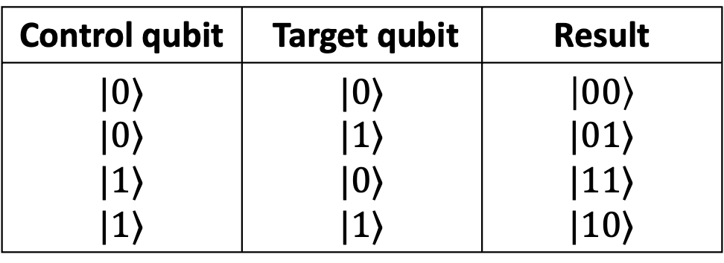

Multi-qubit gate: control-NOT (CX) gate
Control qubit | Target qubit | Result
$$|0⟩$$ $$|0⟩$$ $$|1⟩$$ $$|1⟩$$ | $$|0⟩$$ $$|1⟩$$ $$|0⟩$$ $$|1⟩$$ | $$\left|00\right\rangle$$ $$|01⟩$$ $$|11⟩$$ $$|10⟩$$
$$×$$
$$⨁$$
Flip target if control is $|1⟩$
$$×$$
$$⨁$$
Flip target if control is $|0⟩$
$$CX=\left[\begin{matrix}I & 0 \\ 0 & X\end{matrix}\right]=|0⟩⟨0|⊗I+|1⟩⟨1|⊗X$$
Exercise: Fill this table
1st Control qubit | 2nd Control qubit | Target qubit | Result
? | ? | ? | ?
$$×$$

Slide 11


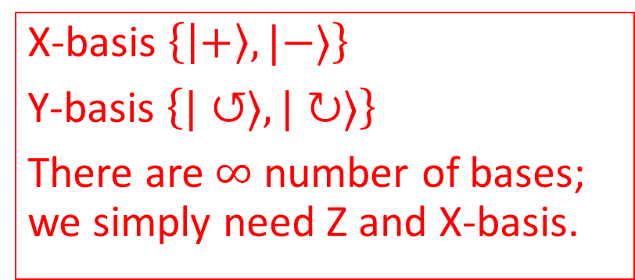


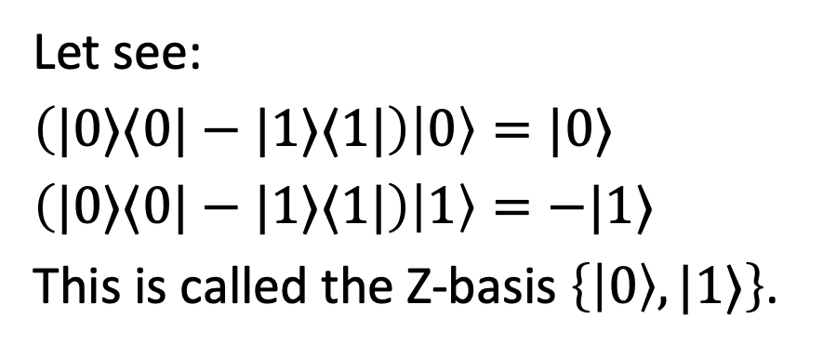







Basis
$$|1⟩$$
$$\left|−\right\rangle$$
$${\left|β\right|}^{2}$$
Let see:
$\left(|0⟩⟨0|−|1⟩⟨1|\right)\left|0\right\rangle =|0⟩$
$\left(|0⟩⟨0|−|1⟩⟨1|\right)\left|1\right\rangle =−|1⟩$
This is called the Z-basis $\left\{\left|0\right\rangle ,|1⟩\right\}$.
$${\left|β\right|}^{2}$$
$$|ψ⟩$$
$$|ψ⟩$$
$${\left|α\right|}^{2}$$
$$⇒$$
$$|0⟩$$
X-basis $\left\{\left|+\right\rangle ,|−⟩\right\}$
Y-basis $\left\{|↺⟩,|↻⟩\right\}$
There are $∞$number of bases; we simply need Z and X-basis.
$${\left|α\right|}^{2}$$
$$\left|+\right\rangle$$

Slide 12





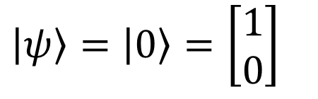




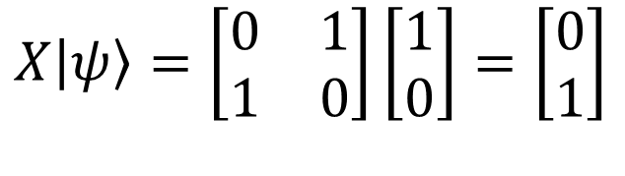

Quantum circuit: single qubit
$\left|ψ\right\rangle =\left|0\right\rangle =\left[\begin{matrix}1 \\ 0\end{matrix}\right]$
$$\left|0\right\rangle$$
$X\left|ψ\right\rangle =\left[\begin{matrix}0 & 1 \\ 1 & 0\end{matrix}\right]\left[\begin{matrix}1 \\ 0\end{matrix}\right]=\left[\begin{matrix}0 \\ 1\end{matrix}\right]$
$$\left|1\right\rangle$$
$$\left|0\right\rangle$$
$$X$$
$$\left|ψ′\right\rangle$$
$$HX\left|ψ\right\rangle =\frac{1}{\sqrt{2}}\left[\begin{matrix}1 & 1 \\ 1 & −1\end{matrix}\right]\left[\begin{matrix}0 & 1 \\ 1 & 0\end{matrix}\right]\left[\begin{matrix}1 \\ 0\end{matrix}\right]=\frac{1}{\sqrt{2}}\left(\left[\begin{matrix}1 \\ −1\end{matrix}\right]\right)$$
$$\left|0\right\rangle$$
$$X$$
$$H$$
$$\left|−\right\rangle$$
Matrix multiplication

Slide 13




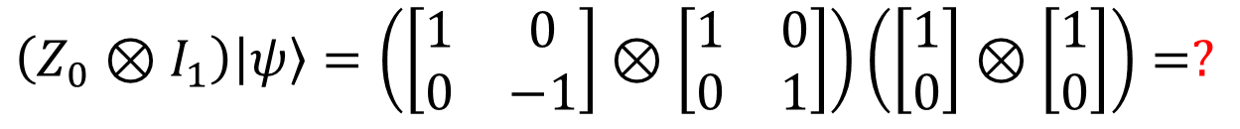
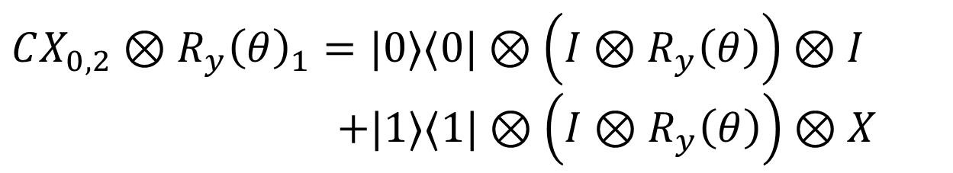




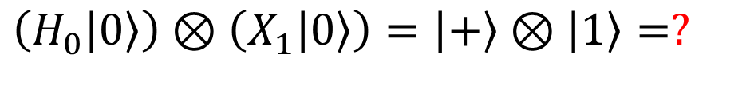














Quantum circuit: multi-qubit
$$\left|0\right\rangle$$
$$H$$
$\left(H_{0}\left|0\right\rangle \right)⊗\left(X_{1}\left|0\right\rangle \right)=\left|+\right\rangle ⊗\left|1\right\rangle =?$
$$\left|0\right\rangle$$
$$X$$
Tensor product
$\left(Z_{0}⊗I_{1}\right)\left|ψ\right\rangle =\left(\left[\begin{matrix}1 & 0 \\ 0 & −1\end{matrix}\right]⊗\left[\begin{matrix}1 & 0 \\ 0 & 1\end{matrix}\right]\right)\left(\left[\begin{matrix}1 \\ 0\end{matrix}\right]⊗\left[\begin{matrix}1 \\ 0\end{matrix}\right]\right)=?$
$$\left|0\right\rangle$$
$$Z$$
“Basic” gate
$$\left|0\right\rangle$$
$$U$$
“Complex” gate
$$\left|0\right\rangle$$
$$Z$$
$$\left|0\right\rangle$$
$$U$$
$$\left|0\right\rangle$$
$$I$$
$$\left|0\right\rangle$$
Exercise: How about this?
$$\left|0\right\rangle$$
$$CX_{0,2}⊗R_{y}{\left(θ\right)}_{1}=|0⟩⟨0|⊗\left({I⊗R}_{y}\left(θ\right)\right)⊗I$$
          $$+|1⟩⟨1|⊗\left(I⊗R_{y}\left(θ\right)\right)⊗X$$
$$\left|0\right\rangle$$
$$R_{y}\left(θ\right)$$
$$\left|0\right\rangle$$
$$⨁$$

Slide 14



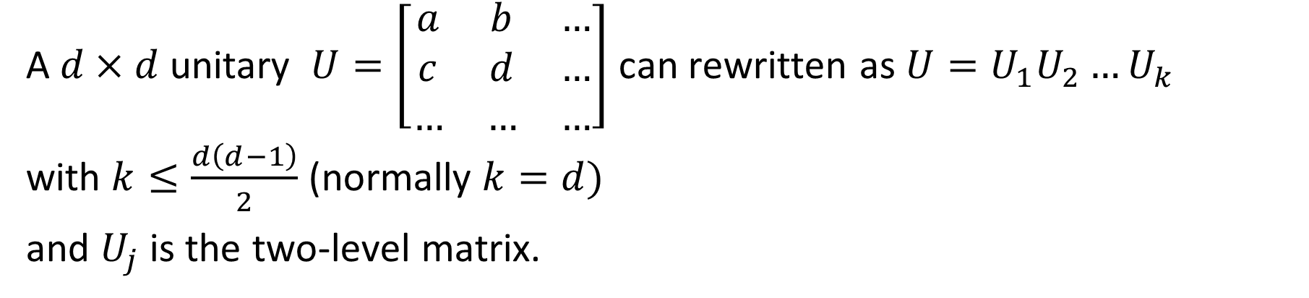





Arbitary gate / circuit
A$d×d$ unitary $U=\left[\begin{matrix}a & b & … \\ c & d & … \\ … & … & …\end{matrix}\right]$ can rewritten as $U=U_{1}U_{2}…U_{k}$
with $k≤\frac{d\left(d−1\right)}{2}$ (normally $k=d)$
and $U_{j}$ is the two-level matrix.
Readmore: Two-level matrix
How to transform $\left\{U_{j}\right\}$ into gates?
$$1$$
$$⋱$$
$$U=$$
$$\begin{matrix}a & b \\ c & d\end{matrix}$$
Use single-qubit gate and CX gate
$$⋱$$
$$1$$
$$\tilde{U}$$
Note: Multi-control X (MCX) gate can be decomposed into single-qubit and CX gate.

Slide 15






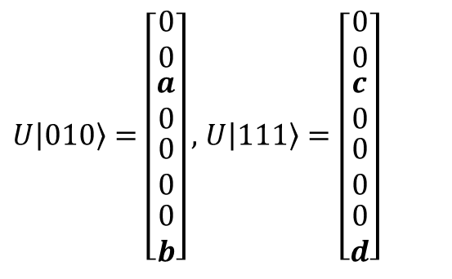

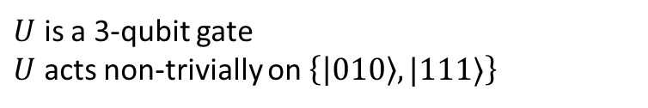




Arbitary gate / circuit
*Excercise: Implement this gate using $\tilde{U}=\left[\begin{matrix}a & c \\ b & d\end{matrix}\right]$ and MCX gate
$U$ is a 3-qubit gate
$U$ acts non-trivially on $\left\{\left|010\right\rangle ,|111⟩\right\}$
$$U=\left[\begin{matrix}\begin{matrix}\begin{matrix}1 & 0 \\ 0 & 1\end{matrix} & \begin{matrix}0 & 0 \\ 0 & 0\end{matrix} \\ \begin{matrix}0 & 0 \\ 0 & 0\end{matrix} & \begin{matrix}a & 0 \\ 0 & 1\end{matrix}\end{matrix} & \begin{matrix}\begin{matrix}0 & 0 \\ 0 & 0\end{matrix} & \begin{matrix}0 & 0 \\ 0 & 0\end{matrix} \\ \begin{matrix}0 & 0 \\ 0 & 0\end{matrix} & \begin{matrix}0 & c \\ 0 & 0\end{matrix}\end{matrix} \\ \begin{matrix}\begin{matrix}0 & 0 \\ 0 & 0\end{matrix} & \begin{matrix}0 & 0 \\ 0 & 0\end{matrix} \\ \begin{matrix}0 & 0 \\ 0 & 0\end{matrix} & \begin{matrix}0 & 0 \\ b & 0\end{matrix}\end{matrix} & \begin{matrix}\begin{matrix}1 & 0 \\ 0 & 1\end{matrix} & \begin{matrix}0 & 0 \\ 0 & 0\end{matrix} \\ \begin{matrix}0 & 0 \\ 0 & 0\end{matrix} & \begin{matrix}1 & 0 \\ 0 & d\end{matrix}\end{matrix}\end{matrix}\right]$$
$U\left|010\right\rangle =\left[\begin{matrix}\begin{matrix}\begin{matrix}0 \\ 0\end{matrix} \\ \begin{matrix}a \\ 0\end{matrix}\end{matrix} \\ \begin{matrix}\begin{matrix}0 \\ 0\end{matrix} \\ \begin{matrix}0 \\ b\end{matrix}\end{matrix}\end{matrix}\right],$ $U\left|111\right\rangle =\left[\begin{matrix}\begin{matrix}\begin{matrix}0 \\ 0\end{matrix} \\ \begin{matrix}c \\ 0\end{matrix}\end{matrix} \\ \begin{matrix}\begin{matrix}0 \\ 0\end{matrix} \\ \begin{matrix}0 \\ d\end{matrix}\end{matrix}\end{matrix}\right]$
Gray-code:
$$\left|010\right\rangle →\left|011\right\rangle →\left|111\right\rangle →\left|011\right\rangle →|010⟩$$
$$0$$
Differ at $0$
$$0$$
$$\tilde{U}$$
$$1$$
$$1$$
$$1$$
$$⨁$$
$$1$$
$$⨁$$
*Exercise 4.39, Nielsen, M. A., & Chuang, I. L. (2010). Quantum computation and quantum information. Cambridge university press.
Notes:
Returning to the general case, we see that implementing the two-level unitary operation U requires at most 2(n−1) controlled operations to swap |g1 with |gm−1 and then back again. Each of these controlled operations can be realized using O(n) single qubit and gates; the controlled-U˜ operation also requires O(n) gates. Thus, implementing U requires O(n^2) single qubit and gates. We saw in the previous section that an arbitrary unitary matrix on the 2^n-dimensional state space of n qubits may be written as a product of O(2^2n) = O(4^n) two-level unitary operations. Combining these results, we see that an arbitrary unitary operation on n qubits can be implemented using a circuit containing O(n^2 x 4^n) single qubit and gates. Obviously, this construction does not provide terribly efficient quantum circuits! However, we show in Section 4.5.4 that the construction is close to optimal in the sense that there are unitary operations that require an exponential number of gates to implement. Thus, to find fast quantum algorithms we will clearly need a different approach than is taken in the universality construction.

Slide 16






























Equivalent gate / circuit
$$H$$
$$H$$
$$≡$$
$$U$$
$$U^{†}$$
$$H$$
$$H$$
$$⨁$$
$$≡$$
$$H$$
$$⨁$$
$$H$$
$$T$$
$$≡$$
$$T^{†}$$
$$⨁$$
$$T^{†}$$
$$⨁$$
$$S$$
$$⨁$$
$$H$$
$$⨁$$
$$T^{†}$$
$$⨁$$
$$T$$
$$⨁$$
$$T^{†}$$
$$⨁$$
$$T$$
$$H$$
Toffoli (CCX) gate
Decompose into 6 CX gates

Slide 17










Parameterized quantum circuit (PQC)
$$R_{Y}\left(θ_{0}\right)$$
(Main) qubits
$$R_{X}\left(θ_{2}\right)$$
$$V\left(θ_{4−7}\right)$$
$$R_{X}\left(θ_{1}\right)$$
$$R_{Z}\left(θ_{3}\right)$$
$${\left|0\right\rangle }^{⊗m}$$
Ancilla qubits
$$U\left(θ\right)$$
$${\left|0\right\rangle }^{⊗n}$$
Trainable parameter
Classical channel
1-qubit gates
2-qubit gates
multi-control gate
complex gate
$$c$$
$θ={\left[\begin{matrix}θ_{0} & θ_{1} & …\end{matrix}\right]}^{⊺}$
*Benedetti, M et al, Parameterized quantum circuits as machine learning models. Quantum Science and Technology, 4(4), 043001 (2019)
Notes:
Vector đầu vào được ánh xạ sang không gian Hilbert $φ(x)$ bằng Encoder $U_{φ}$.
Circuit $U(θ)$ tác động và trả về $U\left(θ\right)Uφ\left(x\right){\left|0\right\rangle }^{⊗\left(n+m\right)}$.
Tập các observable $\{M_{i}\}$ hỗ trợ thao tác đo, ánh xạ trạng thái lượng tử tới không gian output thông qua hàm $f$.

Slide 18
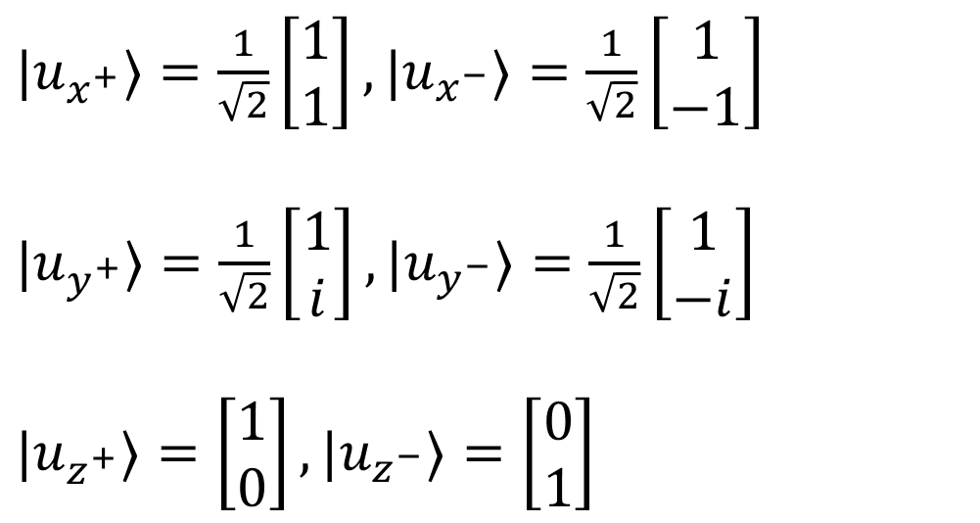
Measurement
All Pauli matrices have eigenvalues $±1$ and its eigenvectors (eigenstates):
$|u_{x^{+}}⟩=\frac{1}{\sqrt{2}}\left[\begin{matrix}1 \\ 1\end{matrix}\right],|u_{x^{−}}⟩=\frac{1}{\sqrt{2}}\left[\begin{matrix}1 \\ −1\end{matrix}\right]$
$|u_{y^{+}}⟩=\frac{1}{\sqrt{2}}\left[\begin{matrix}1 \\ i\end{matrix}\right],|u_{y^{−}}⟩=\frac{1}{\sqrt{2}}\left[\begin{matrix}1 \\ −i\end{matrix}\right]$
$|u_{z^{+}}⟩=\left[\begin{matrix}1 \\ 0\end{matrix}\right],|u_{z^{−}}⟩=\left[\begin{matrix}0 \\ 1\end{matrix}\right]$
Exercise: What are eigenstates of Identity matrix ($0^{th}$ Pauli matrix)?

Slide 19



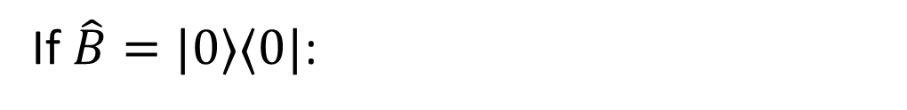

Measurement
$$\left\langle x | x\right\rangle =1,\left\langle x | y\right\rangle =0$$
We can get expectation value through observable $\hat{B}$:
$$⟨E⟩=⟨ψ|\hat{B}|ψ⟩$$
If $\hat{B}=|0⟩⟨0|$:
$$⟨E⟩=\left\langle ψ | 0\right\rangle \left\langle 0 | ψ\right\rangle ={\left|\left\langle 0 | ψ\right\rangle \right|}^{2}$$
If $\left|ψ\right\rangle =α\left|0\right\rangle +β|1⟩:$
$$\left\langle E\right\rangle ={\left|α\right|}^{2}=p(0)$$
Note that: $\left\langle Z\right\rangle =\left\langle ψ\left|Z\right|ψ\right\rangle =p\left(0\right)−p(1)$

Slide 20

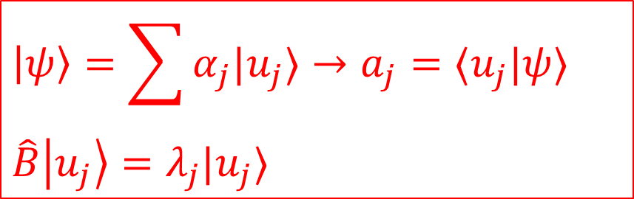


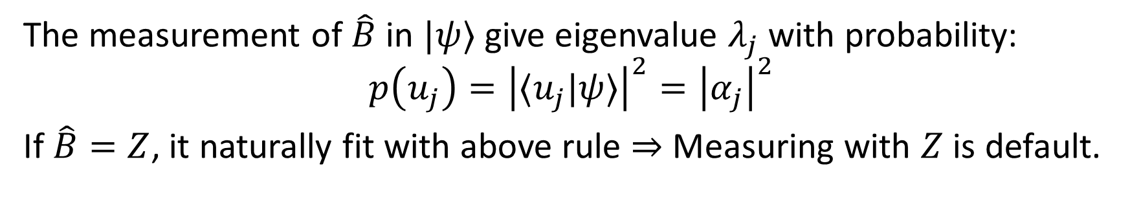



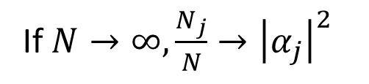

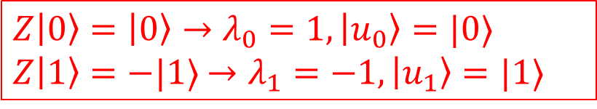


Measurement
$$\left|ψ\right\rangle =\sum{α_{j}|u_{j}⟩}→a_{j}=⟨u_{j}|ψ⟩$$
$$\hat{B}\left|u_{j}\right\rangle =λ_{j}|u_{j}⟩$$
$Z\left|0\right\rangle =\left|0\right\rangle →λ_{0}=1,\left|u_{0}\right\rangle =|0⟩$
$Z\left|1\right\rangle =−|1⟩$ $→λ_{1}=−1,\left|u_{1}\right\rangle =|1⟩$
The measurement of $\hat{B}$ in $|ψ⟩$ give eigenvalue $λ_{j}$ with probability:
$$p\left(u_{j}\right)={\left|⟨u_{j}|ψ⟩\right|}^{2}={\left|α_{j}\right|}^{2}$$
If $\hat{B}=Z$, it naturally fit with above rule $⇒$ Measuring with $Z$ is default.
$$Z$$
$$f$$
$$N_{1}/N$$
Receive eigenvalue
$$c∈\left\{λ_{0},λ_{1}\right\}$$
$$N_{0}/N$$
If $N→∞,\frac{N_{j}}{N}→{\left|α_{j}\right|}^{2}$
$$c$$
Repeat $N$ times
$$λ_{0}$$
$$λ_{1}$$

Slide 21
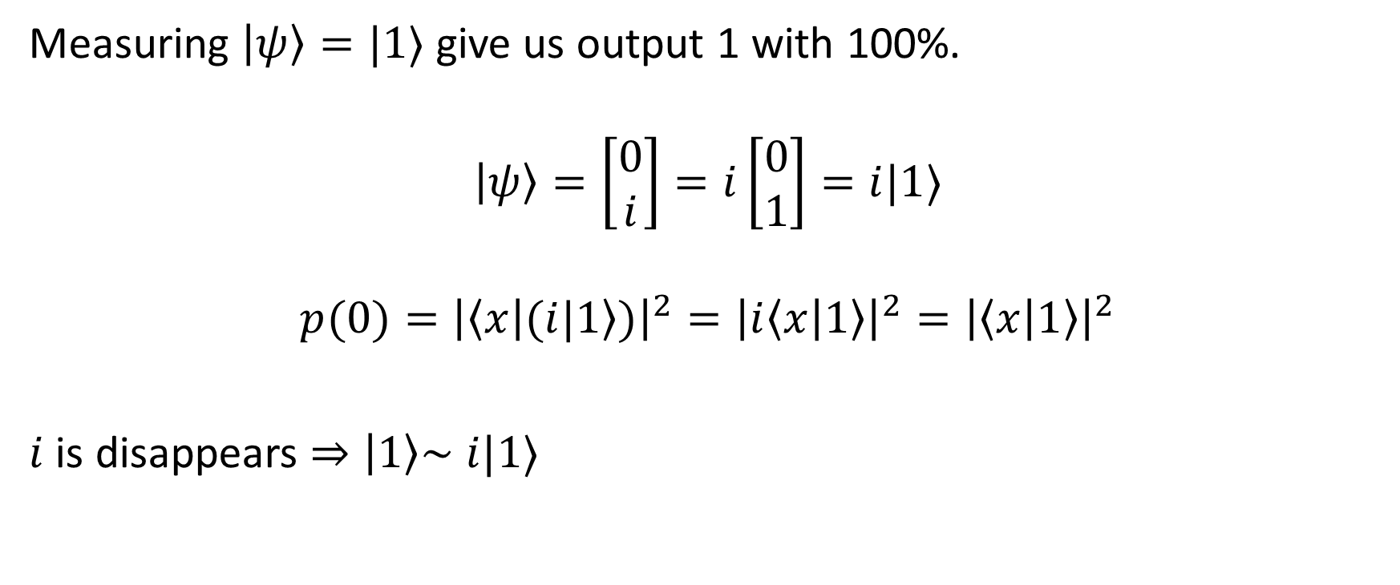
Measurement: global phase
Measuring $\left|ψ\right\rangle =|1⟩$ give us output 1 with 100%.
$$\left|ψ\right\rangle =\left[\begin{matrix}0 \\ i\end{matrix}\right]=i\left[\begin{matrix}0 \\ 1\end{matrix}\right]=i|1⟩$$
$$p(0)={\left|\left\langle x | (i|1\right\rangle )\right|}^{2}={\left|i\left\langle x | 1\right\rangle \right|}^{2}={\left|\left\langle x | 1\right\rangle \right|}^{2}$$
$i$ is disappears $⇒\left|1\right\rangle \sim$ $i|1⟩$
Notes:
Global phases are artefacts of the mathematical framework you are using, and have no physical meaning.
On the other hand, we have the concept “relative phase”. States differing by a relative phase are different systems

Slide 22
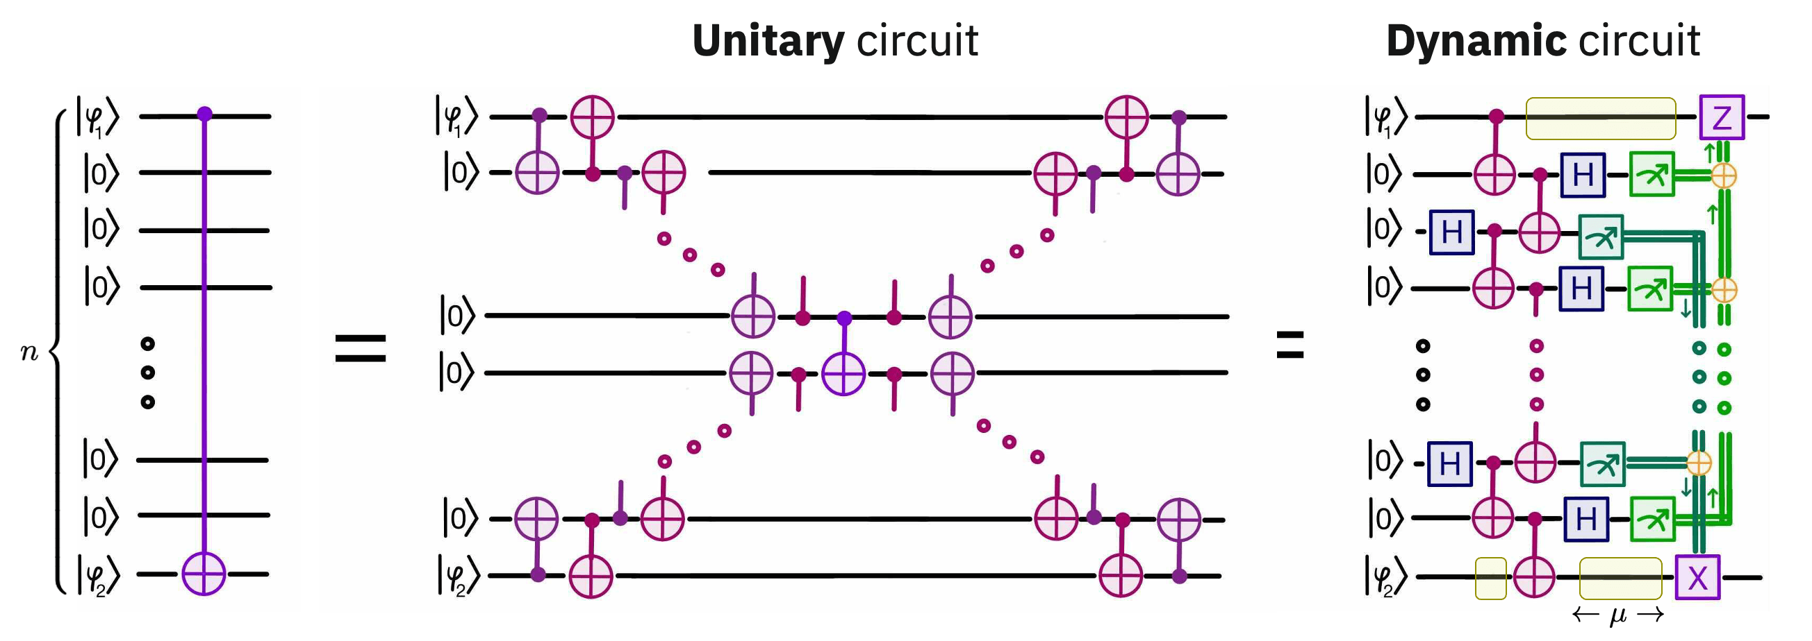




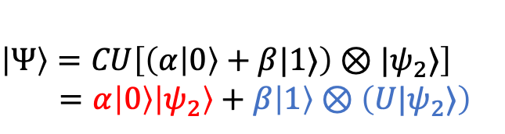
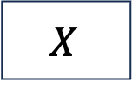








Measurement commutes with controls*
$$X$$
$$≡$$
$$|0⟩$$
If we get 1
then apply $X$
$$|ψ_{1}⟩$$
If we get 0
$$≡$$
If we get 1
$$|ψ_{2}⟩$$
$$U$$
$$U$$
$$|ψ_{2}⟩$$
$$U|ψ_{2}⟩$$
$$\left|Ψ\right\rangle =\left|ψ_{1}\right\rangle ⊗|ψ_{2}⟩$$
Control-U $≡CU$
$$\left|Ψ\right\rangle =CU\left[\left(α\left|0\right\rangle +β|1⟩\right)⊗|ψ_{2}⟩\right]$$
$=α\left|0\right\rangle \left|ψ_{2}\right\rangle +β\left|1\right\rangle ⊗\left(U|ψ_{2}⟩\right)$
*Exercise 4.35, Nielsen, M. A., & Chuang, I. L. (2010). Quantum computation and quantum information. Cambridge university press.
**Bäumer, E., … (2024). Efficient long-range entanglement using dynamic circuits. PRX Quantum, 5(3), 030339.
Read more: Dynamic circuit**

Slide 23
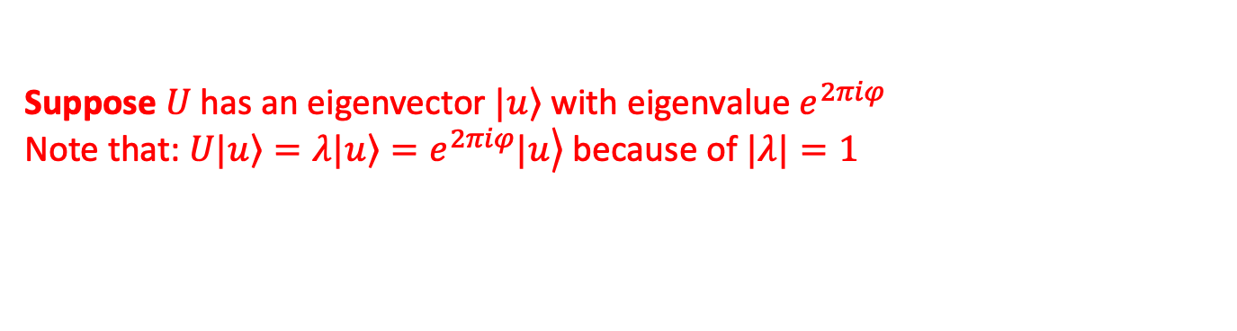










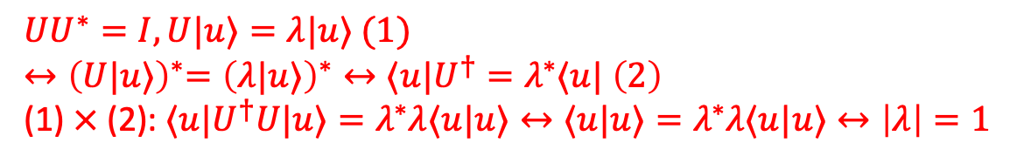

Measuring an operator
$$|0⟩$$
$$H$$
$$H$$
$λ$ is kicked back from $U$
$$|u_{in}⟩$$
$$U$$
$$|u_{out}⟩$$
$\frac{1}{\sqrt{2}}\left(|0⟩|u_{in}⟩\right) if λ=1$
$$\left|u_{in}\right\rangle =\left|u_{out}\right\rangle =\left|u\right\rangle$$
$\left|0u_{in}\right\rangle \underset{→}{H_{0}}\left|+\right\rangle \left|u_{in}\right\rangle \underset{→}{{CU}_{0,1}}\frac{1}{\sqrt{2}}\left(\left|0u_{in}\right\rangle +|1⟩U|u_{in}⟩\right)\underset{→}{H_{0}}$
$=\frac{1}{\sqrt{2}}\left(\left(\left|0\right\rangle +λ|1⟩\right)|u_{in}⟩\right)$
$\frac{1}{\sqrt{2}}\left(|1⟩|u_{in}⟩\right) if λ=−1$
Suppose $U$ has an eigenvector $\left.|u\right\rangle$ with eigenvalue $e^{2πiφ}$
Note that: $U\left.|u\right\rangle =λ\left.|u\right\rangle =\left.e^{2πiφ}|u\right\rangle$ because of $|λ|=1$
$$UU^{∗}=I, U|u⟩=λ|u⟩ (1)$$
${↔\left(U|u⟩\right)}^{∗}={\left(λ|u⟩\right)}^{∗}↔⟨u|U^{†}=λ^{∗}⟨u|$ $\left(2\right)$
(1) $×$(2):$⟨u|U^{†}U|u⟩=λ^{∗}λ⟨u|u⟩↔⟨u|u⟩=λ^{∗}λ⟨u|u⟩↔\left|λ\right|=1$

Slide 24

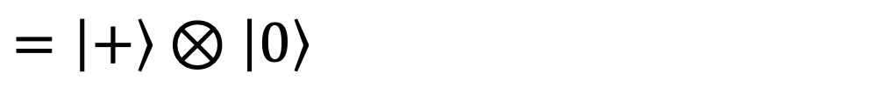
Seperable states
We can write down a state as the tensor product form.
Example:
$$\left|ψ\right\rangle =\frac{1}{\sqrt{2}}\left[\begin{matrix}\begin{matrix}1 \\ 0\end{matrix} \\ \begin{matrix}1 \\ 0\end{matrix}\end{matrix}\right]=\frac{1}{\sqrt{2}}\left|00\right\rangle +\frac{1}{\sqrt{2}}\left|10\right\rangle$$
$$=\frac{1}{\sqrt{2}}\left(\left|0\right\rangle +\left|1\right\rangle \right)\left|0\right\rangle$$
$$=\left|+\right\rangle ⊗\left|0\right\rangle$$

Slide 25
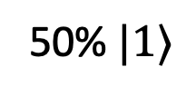

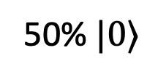
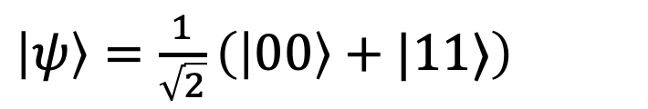

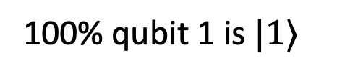

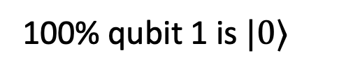
Entangled states
50% $|0⟩$
100% qubit 1 is $|0⟩$
$$|0⟩$$
$$H$$
Measuring qubit 0
$$|0⟩$$
$$⨁$$
50% $|1⟩$
100% qubit 1 is $|1⟩$
We could create the state:
This is known as a Bell state.
$\left|ψ\right\rangle =\frac{1}{\sqrt{2}}\left(\left|00\right\rangle +|11⟩\right)$
Readmore: It’s also called as “spooky action at a distance” / EPR paradox.
Notes:
50% probability of being measured in the state $\left|00\right\rangle ,$ 50% probability of being measured in the state $|11⟩$.

Slide 26



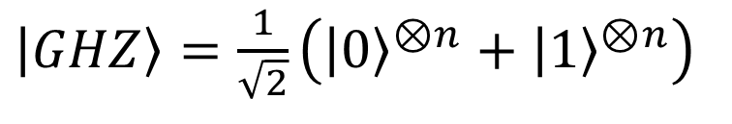















Entangled states: GHZ and W
$\left|GHZ\right\rangle =\frac{1}{\sqrt{2}}\left({\left|0\right\rangle }^{⊗n}+{\left|1\right\rangle }^{⊗n}\right)$
$$|0⟩$$
$$H$$
$$|0⟩$$
$$R_{y}\left(π/2\right)$$
$$|0⟩$$
$$⨁$$
$$|0⟩$$
$$⨁$$
$$|0⟩$$
$$⨁$$
$$|0⟩$$
$$⨁$$
$$⋮$$
$$⋮$$
$$|0⟩$$
$$⨁$$
$$|0⟩$$
$$⨁$$
$\left|W\right\rangle =\frac{1}{\sqrt{2}}\left(\left|00…1\right\rangle +\left|00…10\right\rangle +…+|10…0⟩\right)$
Exercise: How to prepare $\left|W\right\rangle ?$

Slide 27
























Entangled states: GHZ and W
Exercise: How to prepare $\left|W\right\rangle ?$
$\left|W\right\rangle =\frac{1}{\sqrt{2}}\left(\left|00…1\right\rangle +\left|00…10\right\rangle +…+|10…0⟩\right)$
$$|0⟩$$
$$X$$
$$CF\left(θ_{1}\right)$$
$$⨁$$
$$⨁$$
$$⨁$$
$$⋮$$
$$|0⟩$$
$$⨁$$
$$⨁$$
$$⨁$$
$$⋮$$
$$⋱$$
$$CF\left(θ_{1}\right)$$
$$|0⟩$$
$${ W}_{3}$$
$$|0⟩$$
$$|0⟩$$
$$CF\left(θ\right)$$
$$⨁$$
Readmore: Entangled state preparation isn’t a trivial problem.
Entangled State Preparation via Cluster States on Quantum Computers with $\left\langle qo | op\right\rangle$Software, 2025 QSW
$$F\left(\operatorname{acos}\left(1/\sqrt{3}\right)\right)$$
$$⨁$$
$$H$$

Slide 28






Gradient and optimizer
Considering a PQC$U\left(θ\right)=U_{m−1}U_{m−2}…U_{0}$
with associated cost function:
$C\left(θ\right)=f(\left\langle 0\left|U^{†}\left(θ\right)\hat{B}U\left(θ\right)\right|0\right\rangle )$
We want to find:
  $θ^{∗}={argmin}_{θ}C\left(θ\right)$
Gradient
$$U(θ)$$
$$C\left(θ\right)$$
$$∇C$$
$θ^{t+1}←$ Optimizer$(θ,∇C)$
Update $θ$ until $C\left(θ\right)<τ$

Slide 29



Gradient
Computing PQC’s gradient is the key in quantum optimization:
$∇C={\left[\begin{matrix}∂_{θ_{0}}C & … & ∂_{θ_{m−1}}C\end{matrix}\right]}^{⊺}$
The partial derivative can be computed through parameter-shift rule*:
$$\frac{∂C}{∂θ_{j}}=\sum_{k=1}^{R}{d_{k}\left(C\left(θ_{j}^{+ε_{k}}\right)−C\left(θ_{j}^{−ε_{k}}\right)\right)}$$
$C\left(θ_{j}^{+ε_{k}}\right)≡C\left(θ+e_{j}ε_{k}\right)$, $e_{j}$ is the $j^{th}$ unit vector,
$ε_{k}$ is the shift-value, $d_{k}$ is the scalar factor
*D. Wierichs, J. Izaac, C. Wang, and C. Y.-Y. Lin, “General parameter-shift rules for quantum gradients,” Quantum, vol. 6, p. 677, Mar. 2022

Slide 30


Gradient
Parameter-shift rule
Commonly, we only use 2term-PSR
$∂_{θ_{j}}C=\frac{1}{2}\left[C\left(θ_{j}^{+\frac{π}{2}}\right)−C\left(θ_{j}^{−\frac{π}{2}}\right)\right]$
Example:
$f\left(x\right)=\sin{x}$
$f^{′}\left(x\right)=\frac{1}{2}\left[\sin\left(x+\frac{π}{2}\right)−sin⁡(x−\frac{π}{2})\right]$
$=\frac{1}{2}\left[\cos\left(x\right)+cos⁡(x)\right]$ $=cos⁡(x)$
Notes:
Cho C là loss/cost function, tính đạo hàm riêng thứ i bằng phương pháp sai phân hữu hạn, tuy nhiên trong trường hợp này ta tính các hệ số cụ thể. Với các eigenvalues khác nhau, độ dời s và hệ số tự do r sẽ có giá trị khác nhau.
Cách tính cụ thể được trình bày trong paper.

Slide 31

























Encoding
Quantum state preparation*
$$U\left(φ\right)$$
$$\left|ψ_{0}\right\rangle ={\left|0\right\rangle }^{⊗n}$$
$$\left|ψ′\right\rangle =U\left(φ\right)|ψ_{0}⟩$$
with $\left|ψ′\right\rangle$ is the prepared state
How to prepare $U\left(φ\right)?$
For example: $\left|ψ′\right\rangle =\left[\begin{matrix}1/\sqrt{5} & 2/\sqrt{5}\end{matrix}\right]$
$${0.447}_{10}≈{0.0111}_{2}$$
$${0.8944}_{10}≈{0.1110}_{2}$$
$$|0⟩$$
$${ R}_{Y}\left(2.2143\right)$$
$$\left|ψ′\right\rangle =\left[\begin{matrix}1/\sqrt{5} \\ 2/\sqrt{5}\end{matrix}\right]$$
$$|0⟩$$
$$1/\sqrt{5}$$
$n$qubits
$$|0⟩$$
$$X$$
$$|0⟩$$
$$X$$
${M2}^{n}$qubits
$$|0⟩$$
$$X$$
$$|0⟩$$
$$X$$
$$2/\sqrt{5}$$
$$|0⟩$$
$$X$$
$$|0⟩$$
$$X$$
How to find $φ?$
$$|0⟩$$
Basic encoding
Amplitude encoding
*Schuld, M., & Petruccione, F. (2018). Supervised learning with quantum computers. Quantum science and technology, 17.

Slide 32


Encoding
Diff encoders
Encoder
 | Threshold Encoding - TE | Flexible Representation - FRQI | Novel enhanced quantum - NEQR [1.25] | Amplitude Encoding - AE [1.26] & Quantum RAM [1.27] | Divide – and - Conquer Encoder - DCE [1.28] | Universal Compilation – based variational quantum- UC – VQA [1.29]
#qubit | $𝒪(2^{2n})$ | $𝒪(2n+1)$ | $𝒪(2n+1)$ | $𝒪\left(n\right)$ | $𝒪\left(2^{2n}\right)$ | $𝓞\left(n\right)$
Circuit depth | $𝒪(2^{2n})$ | $𝒪(2^{4n})$ | $𝒪(2^{2n})$ | $𝒪\left(2^{2n}\right)$ | $𝒪\left(k\right)$ | $𝓞\left(poly\left(n\right)\right)+𝓞\left(poly\left(n\right)\right)$
Feature
List of encoders
Circuit depth
Resource for $θ_{φ}$
[1.25] Zhang, Y., Lu, K., Gao, Y., & Wang, M, NEQR: a novel enhanced quantum representation of digital images. Quantum information processing, 12, 2833-2860 (2013).
[1.26] M. Weigold et al, Data encoding patterns for quantum computing, in Proceedings of the 27th Conference on Pattern Languages of Programs PLoP ’20, (The Hillside Group, USA, 2022).
[1.27] V. Giovannetti et al, Quantum random access memory, Phys. Rev. Lett. 100 (Apr 2008) p. 160501.
[1.28] I. F. Araujo et al, A divide-and-conquer algorithm for quantum state preparation, Scientific Reports 11 (Mar 2021) p. 6329.
[1.29] Hai, V. T., & Ho, L. B. (2023). Universal compilation for quantum state tomography. Scientific Reports, 13(1), 3750
Notes:
No. qubit = number of qubit
Circuit depth = độ dài của U_phi

Slide 33


Encoding
Time-evolution Unitary approximation
Implementing a time evolution unitary in a quantum circuit is difficult, so we use a Trotter-Suzuki decomposition to perform approximate time evolution:
$$U\left(T\right)=𝒯\exp\left[−i\int_{0}^{T}{H\left(t\right) dt}\right]\underset{→}{discretization}≈𝒯\exp\left[−i\sum_{k=0}^{T/Δt}{H\left(kΔt\right)Δt}\right]$$
Time-ordering operator
Target
$\underset{→}{𝒯} e^{−iβ_{n}H_{d}Δt}{ e}^{−iβ_{n}H_{c}Δt}…e^{−iβ_{1}H_{d}Δt}e^{−iβ_{1}H_{c}Δt}$
$=U_{d}\left(β_{n}\right)U_{C}…U_{d}\left(β_{1}\right)U_{C}$
Implemented by rotation gates
Quantum circuit

Slide 34



















Encoding
Time-evolution Unitary approximation*
We already know that:
$H=\sum{h_{j}P_{j}}$with coefficient $h_{j}∈ℂ$and$P_{j}$is the $n$ - qubit Pauli string
$$U\left(T\right)=\prod_{k=1}^{T/Δt}{\prod_{j}^{ }{e^{−i\left(h_{j}P_{j}\right)Δt}}}$$
Example
$${ e}^{−i\left(Y_{0}Z_{1}\right)\left(\frac{θ}{2}\right)}$$
$$Z=\left(HS^{†}\right)Y\left(SH\right)$$
$${ e}^{−i\left(Z_{0}Z_{1}\right)\left(\frac{θ}{2}\right)}$$
$$H$$
$$S^{†}$$
$$S$$
$$H$$
$${ e}^{−i\left(h_{0}P_{0}\right)Δt}$$
$${ e}^{−i\left(h_{1}P_{1}\right)Δt}$$
$$…$$
$$CX_{0−1}R_{Z}{\left(θ\right)}_{0}CX_{0−1}$$
$$H$$
$$S^{†}$$
$$R_{Z}\left(θ\right)$$
$$S$$
$$H$$
$T/Δt$ times
Readmore: *qml.ApproxTimeEvolution

Slide 35








Quantum embedding (embedding $x$ into $U)$
$$U_{φ}\left(x\right)$$
$$\left|ψ_{0}\right\rangle ={\left|0\right\rangle }^{⊗n}$$
$$\left|ψ(x)\right\rangle =U_{φ}\left(x\right)|ψ_{0}⟩$$
For example: $x=\left[\begin{matrix}1 & 2 & 3\end{matrix}\right]$
$$R_{y}\left(x[0]\right)$$
$$R_{y}\left(x[1]\right)$$
$$R_{y}\left(x[2]\right)$$
Readmore:
https://docs.pennylane.ai/en/stable/introduction/templates.html

Slide 36




Quantum optimization
Considering a PQC:
  $U\left(θ\right)=U_{m−1}U_{m−2}…U_{0}$
and cost function:
$C\left(θ\right)=⟨0\left|U^{†}\left(θ\right)\hat{B}U\left(θ\right)\right|0⟩$
We want to find:
  $θ^{∗}={argmin}_{θ}C\left(θ\right)$
Trainable parameters
Objective associated with expectation values
Optimal parameters
$$U(θ)$$
$$C\left(θ\right)$$
$$∇C$$
$θ^{t+1}←$ Optimizer$(θ,∇C)$
Update $θ$ until $C\left(θ\right)<τ$
Quantum computer
Classical computer

Slide 37




Notation
$$n$$
$$q$$
$$U$$
qc.measure([0, 1, 2], [0, 1, 2])
qc.h(0)
qc.cx(0, 1)
qc.cx(1, 2)
qc = QuantumCircuit(3, 3)
$$c$$
simulator = AerSimulator(method = 'statevector')
result = simulator.run(qc, shots=1000).result().get_counts()

Slide 38

from qiskit.circuit import ParameterVector
thetas = ParameterVector('theta', 3)
qc.rx(thetas[0], 0)
qc.ry(thetas[1], 1)
qc.crz(thetas[2], 2, 0)
$$n$$
$$q$$
$U\left(θ\right)$
$$c$$

Slide 39









transpile(qc, backend, basis_gates)
$U$
$$=$$
$$R_{y}(…)$$
$$⊕$$
$$R_{y}(θ)$$
$$R_{y}(…)$$
$$R_{y}(θ)$$
$$R_{y}(θ)$$
$$⊕$$
$$≡$$
$$⋮$$
$$⊕$$
$$×L$$
$$R_{y}(…)$$
$$\{ \}$$
: basis gates
qc.append(my_gate_1, [0, 1])
$$q_{0}$$
MyGate1
$$q_{1}$$
$$q_{2}$$

